Slide 1
750 Cases Studies
Vaginal Laser Rejuvination
Dr JOVANOVIC Stevan, Dr HAAG Thierry, Dr ANDRE Pierre
Institut Médical de Champel GENEVE

Slide 2
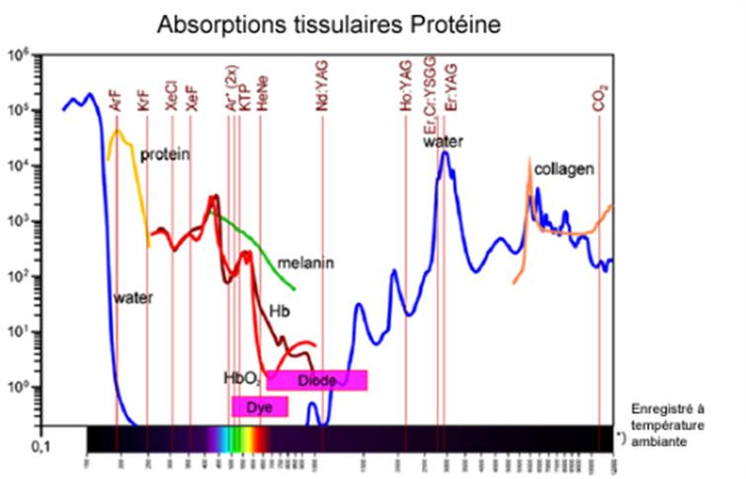
Laser Specificity

Slide 3
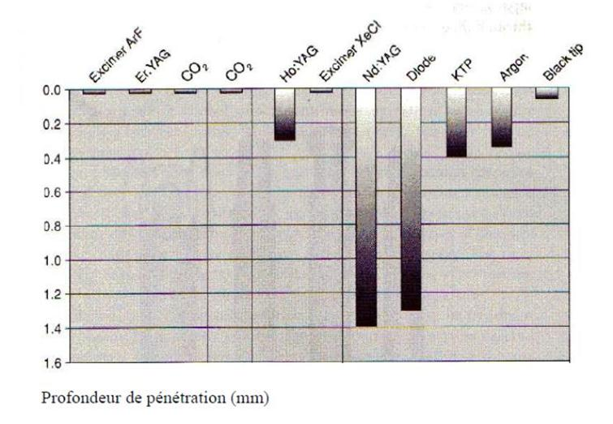
Penetration in depth

Slide 4
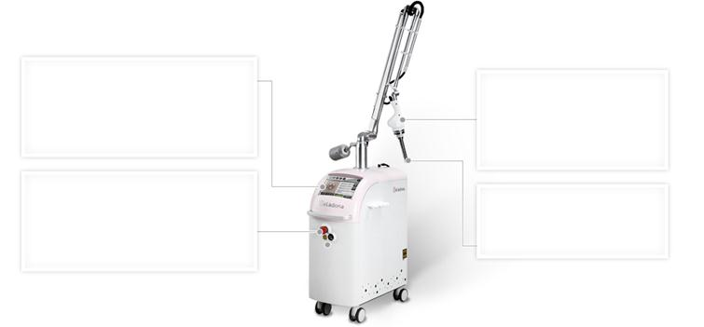
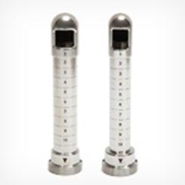
Beladona Laser WONTECK

Slide 5
W Pulse
W-Pulse for rejuvenation
· Combination of ablation and micro thermal effect
· Generating micro thermal effect after high peak irradiation during a pulse

Slide 6
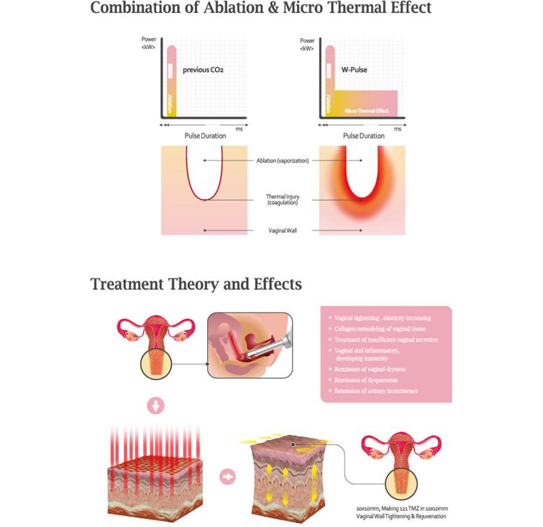

Slide 7
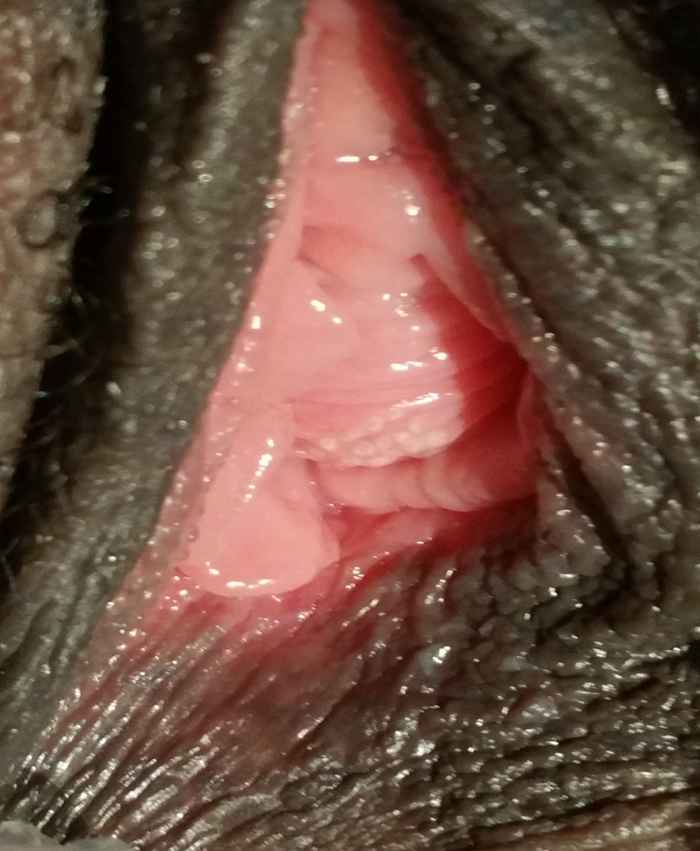
Spots

Slide 8
Effects (from litterature)
Vaginal Tightening, Increasing elasticity
Improve vaginal dryness and vaginal shrinking
Reduce dyspareunia
Increase sexual pleasure
Whitening labia
Vaginal anti inflammatory, developing immunity

Slide 9
Cells…
Laser Co2 activates dormant fibrocystes changing them into fibroblasts.
Fibroblast activates biosynthesis of new collagen and produce main component of ground substance.
Procollagen, Hyaluronic acid
We regain premenopausal healthy vaginal
Natural pink color
Ruggae
Lubrification

Slide 10
Advantages of laser treatment
Short Treatment time
No need for anesthesia
No pain
No need for shaving
No bleeding, no side effect
No down time

Slide 11
Specification Of Beladonna
Irradiation Type | RF CO₂ Laser
Wavelength | 10,600 nm
Repetition Rate | Fractional Mode : 1 ~ 10 kHz W pulse Mode : 45~22Hz
Spot Size | 1 x 1 ~ 20 x 20 mm
Pulse Duration | Fractional Mode : 1 ~ 3,000μs W pulse Mode : 1.05~17.0ms
Maximum Energy | Fractional mode : 115mJ, W Pulse mode : 200mJ

Slide 12
Protocol
2 treatments separated from 2 weeks
750 cases
Over 1 year and half
Population studied
Menopausal women Dryness
Tightening after deliver
Urinary incontinence
Recurrent infection

Slide 13
Symptoms
Total : 752
Symptoms | Number | Pourcent
Tightening | 324 | 43%
Dryness | 203 | 26%
Urinary symptoms | 183 | 24%
Infections | 42 | 5%

Slide 14
Tightening
 | Initial | Improved « feel better » | Pourcentage
Slight | 253 | 221 | 87%
Moderate | 147 | 132 | 90%
Considerable | 24 | 18 | 75%

Slide 15
Dryness (203 patients)
 | Initial | Improved « feel better » | Pourcentage
Slight | 142 | 121 | 85%
Moderate | 38 | 32 | 84%
Considerable | 23 | 20 | 87%

Slide 16
Urinary symptoms (145 pt)
 | Initial | Improved « feel better » | Pourcentage
Slight | 92 | 83 | 90%
Moderate | 43 | 34 | 79%
Considerable | 20 | 11 | 55%

Slide 17
Infection (vaginal / urinary)
 | Initial | Improved « feel better » | Pourcentage
3x/year | 27 | 22 | 81%
3-7x /year | 8 | 6 | 75%
>7x/ year | 7 | 4 | 57%

Slide 18
Conclusion:
As expected we can see a clear benefit (over 80%) to treat patient.
More the problem is important less the favorable is the outcome. Except for dryness, where all categories have advantages.
In our experience if the patient has no benefit after 2 sessions, there is no benefirt to treat more.
Don t garantee results, but you can say the treatment works.

